Slide 1
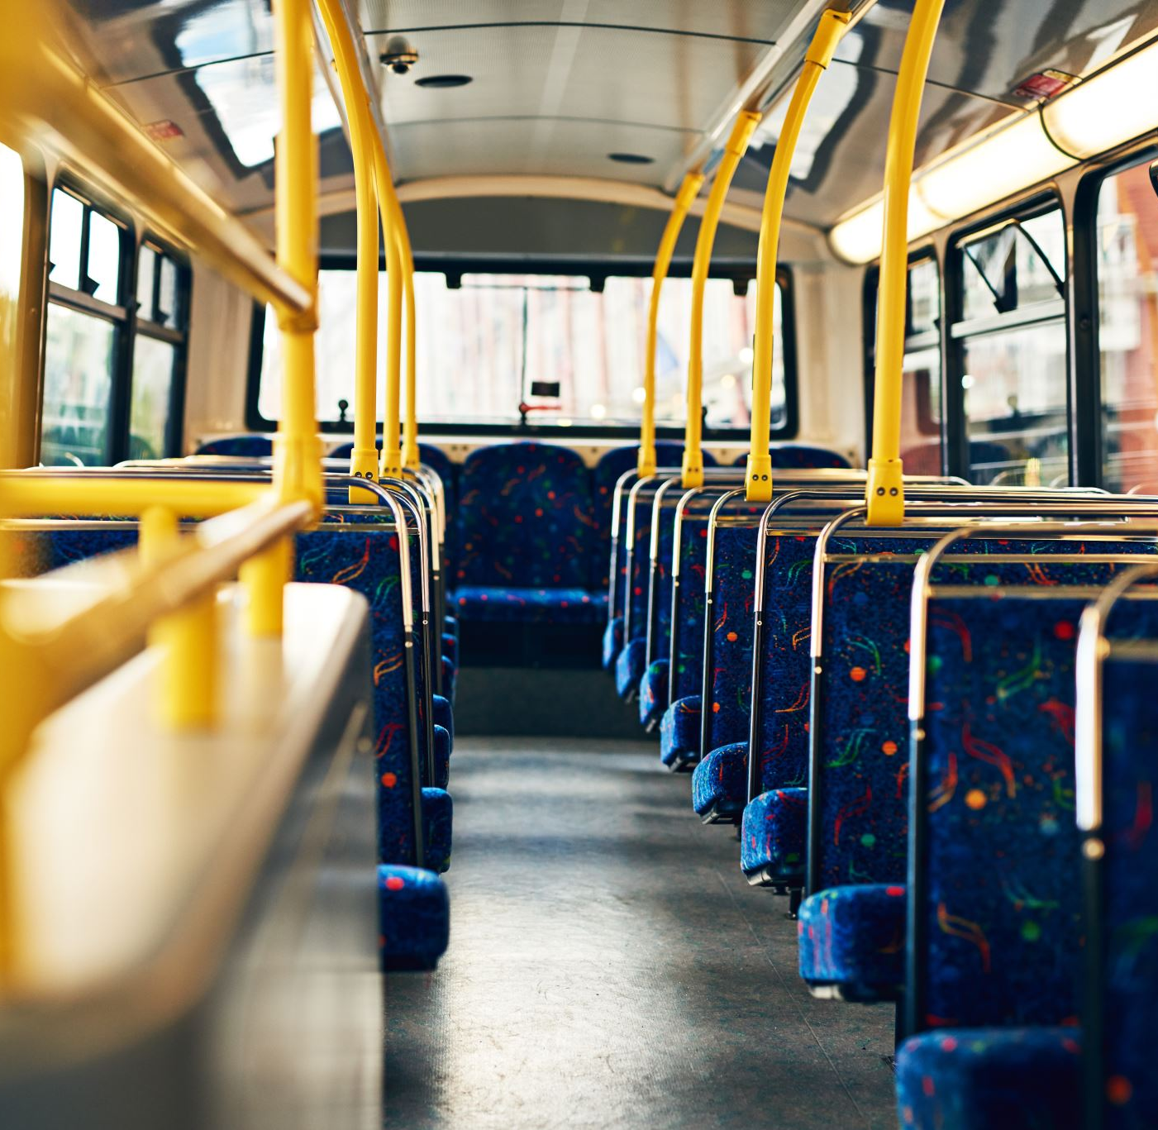
BUS RESERVATION SYSTEM
MET CS 669
DATABASE DESIGN AND IMPLEMENTATION FOR BUSINESS
Shailesh, Niranjana, Ozee, Maka

Slide 2
Content
Background and objectives
Use Cases
Tables and attributes
Business Rules
Entity relationship diagram
SQL STATEMENTS
Conclusion

Slide 3


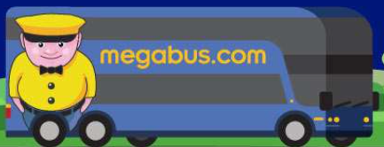
Overview
High speed wireless network has led to proliferation of mobile and web applications.
Booking a reservation for any mode transportation, flights and buses, for example, is now easy and convenient.
With high volume of data coming in via reservations, a well-designed database is needed to store the data efficiently.
Keeping that in mind, we have designed a database that stores and manages data related to the bus reservation system.
Serve as a backend for mobile/web applications that supports bus reservations.

Slide 4
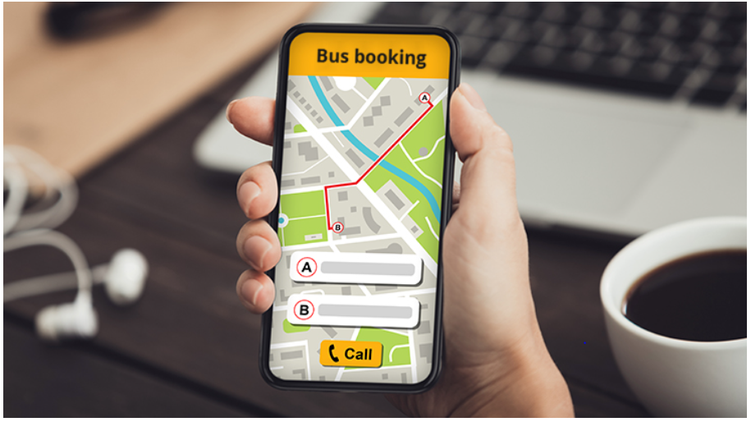
Use cases
Use Case # 1 – Customer makes one or more reservations
User opens Easy Bus web application.
Easy Bus app displays a search bar containing origin, destination, and trip dates.
User enters origin, destination, and trip dates.
Easy Bus app displays list of buses available and price for the trip.
User selects the bus of his/her choice.
Easy Bus app redirects to seat selection page.
User selects seats, and clicks next.
Easy Bus app redirects user to transaction page.
User enters personal information, credit card credentials and clicks submit.
Easy Bus app displays a confirmation message if transaction is successful.
Source: https://www.allrideapps.com/how-to-boost-sales-in-your-online-bus-reservation-software/

Slide 5
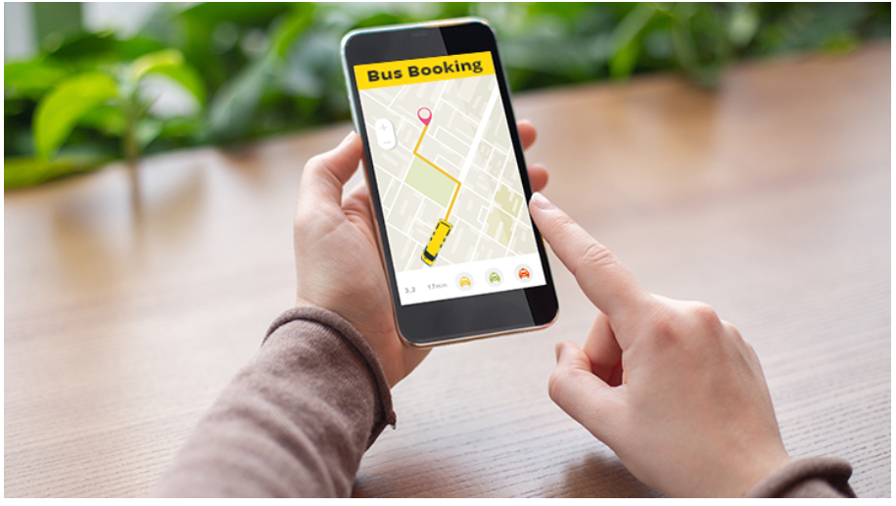
Use Cases
Use Case # 2 – Customer tracks the location of the bus
User opens Easy Bus web application, and clicks Track.
Easy Bus app prompts users to enter bus information.
User enters the bus number.
Easy Bus app displays location of the bus.
Source: https://www.allrideapps.com/how-to-boost-sales-in-your-online-bus-reservation-software/

Slide 6
Entities and attributes
Passenger
Reservation
Reservation ID
Transaction
Transaction ID
Bus
Bus ID
Schedule
Schedule ID,
Tracker
Tracker ID
Amenities
Amenities ID
Passenger ID
First Name
Last Name,
Gender
Email
Cell Number
Seat Number
Date Booked
Status
Start City
Destination City
Fare
Arrival Time
Departure Time
Location
Meals
WiFi
Bathroom

Slide 7

Business Rules
Each passenger can have exactly one reservation; Each reservation can belong to only one passenger.
Each transaction can have many reservations; Each reservation is associated with exactly one transaction.
Each bus can have many reservations; Each reservation belongs to exactly one bus.
Each bus can have many schedules; Each schedule belongs to one bus.
Each bus has many tracking locations, Each tracking location belongs to one bus.

Slide 8
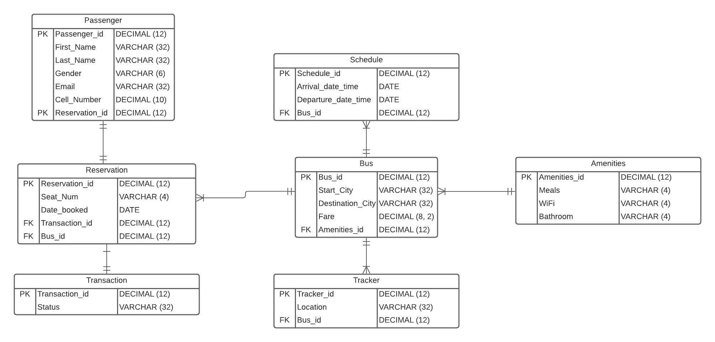
Entity Relationship Diagram

Slide 9
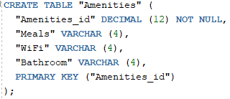
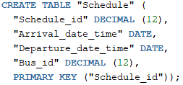

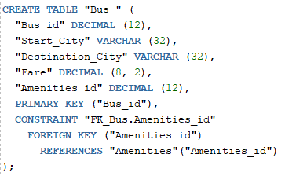
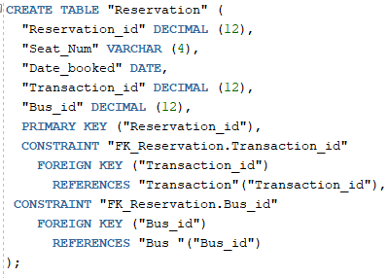
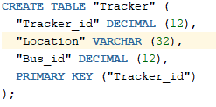
SQL Statements
CREATE statement

Slide 10
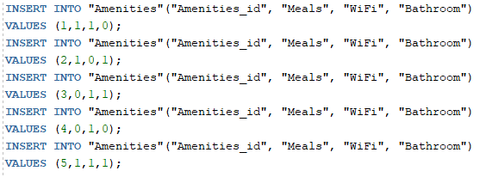
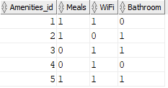
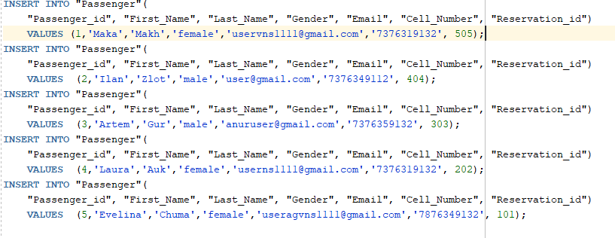
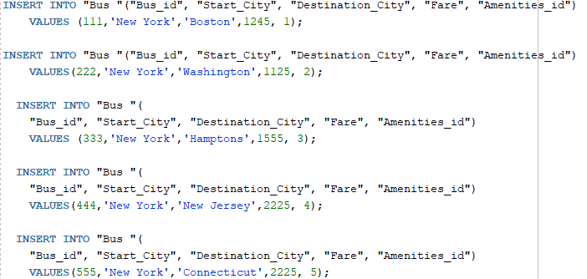
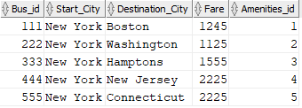
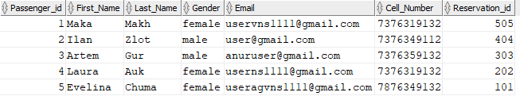
SQL Statements
INSERT statements

Slide 11
SQL Statements
CREATE

